Slide 1
STI CLINICAL TRIALS 2023
This data includes information on 188 clinical trials studying vaccines, diagnostics, and the use of doxycycline post-exposure prophylaxis (DoxyPEP) to detect, treat, and prevent sexually transmitted infections (STIs).
Notes:
This slide set was prepared by AVAC. These slides display trends for active trials from clinicaltrials.gov as of June 2023. Underlying data is available for download at https://stiwatch.org/sti-database/
NOTE: This slide set is in the public domain. You may reproduce these slides without permission; however, citation as to source is appreciated.
You are also free to adapt and revise these slides; however, you must remove the AVAC STIWatch name and logo if changes are made.

Slide 2
Background
The database includes information on 188 trials focusing on vaccines, diagnostics, and the use of doxycycline post-exposure prophylaxis (DoxyPEP) to detect, treat, and prevent chlamydia, gonorrhea, hepatitis B, herpes simplex virus (HSV), human papillomavirus, syphilis and trichomoniasis.
This information is derived from the clinicaltrials.gov online database.
Only trials listed as active as of June 2023, have been included in this dashboard and trials that include more than one pathogen have been classified as “multi-pathogen trials”.
Notes:
This slide set was prepared by AVAC. These slides display trends for active trials from clinicaltrials.gov as of June 2023. Underlying data is available for download at https://stiwatch.org/sti-database/
NOTE: This slide set is in the public domain. You may reproduce these slides without permission; however, citation as to source is appreciated.
You are also free to adapt and revise these slides; however, you must remove the AVAC STIWatch name and logo if changes are made.

Slide 3
Key Points
Clinical trials are important to understand if new tools, including vaccines and diagnostics, are safe and effective in detecting, treating, and preventing STIs.
The majority of STI clinical trials reported focused on HPV, similar to funding data that describes large investments in HPV. To learn more about STI funding refer to AVACs STI resource tracking report.
There are several trails that include the study of multiple STIs, including HIV, highlighting the growing importance and need for multipurpose prevention technologies.
Currently, there are more clinical trials focused on vaccines compared to diagnostics.
It is important to note that many new diagnostics undergo vigorous evaluations before getting regulatory approval and these studies are not always considered or reported as a clinical trial.
Notes:
This slide set was prepared by AVAC. These slides display trends for active trials from clinicaltrials.gov as of June 2023. Underlying data is available for download at https://stiwatch.org/sti-database/
NOTE: This slide set is in the public domain. You may reproduce these slides without permission; however, citation as to source is appreciated.
You are also free to adapt and revise these slides; however, you must remove the AVAC STIWatch name and logo if changes are made.

Slide 4
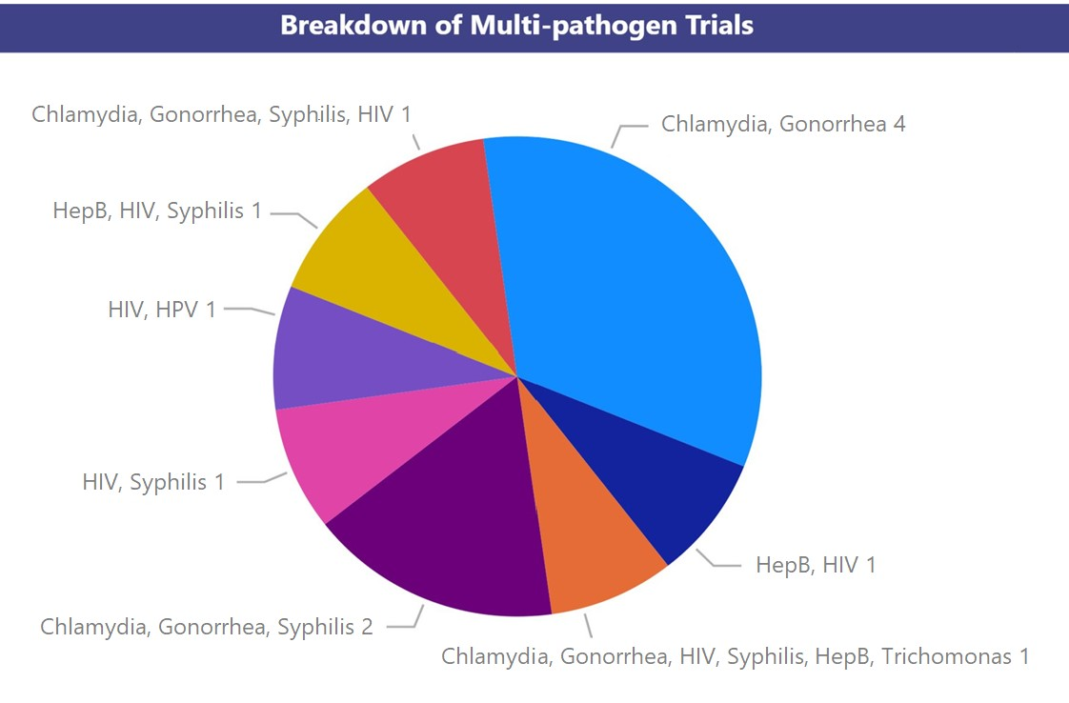
Trials by Pathogen
n = 188
Notes:
The graphs on this slide illustrate the imbalance of pathogens being investigated in the active trials listed on clinicaltrials.gov.
This slide set was prepared by AVAC. These slides display trends for active trials from clinicaltrials.gov as of June 2023. Underlying data is available for download at https://stiwatch.org/sti-database/
NOTE: This slide set is in the public domain. You may reproduce these slides without permission; however, citation as to source is appreciated.
You are also free to adapt and revise these slides; however, you must remove the AVAC STIWatch name and logo if changes are made.

Slide 5
Trials by Study Purpose
n = 188
Notes:
The “Trials by Purpose” graph on this slide highlights research priorities in STI R&D. Funding is heavily skewed towards STI Vaccine research.
This slide set was prepared by AVAC. These slides display trends for active trials from clinicaltrials.gov as of June 2023. Underlying data is available for download at https://stiwatch.org/sti-database/
NOTE: This slide set is in the public domain. You may reproduce these slides without permission; however, citation as to source is appreciated.
You are also free to adapt and revise these slides; however, you must remove the AVAC STIWatch name and logo if changes are made.

Slide 6
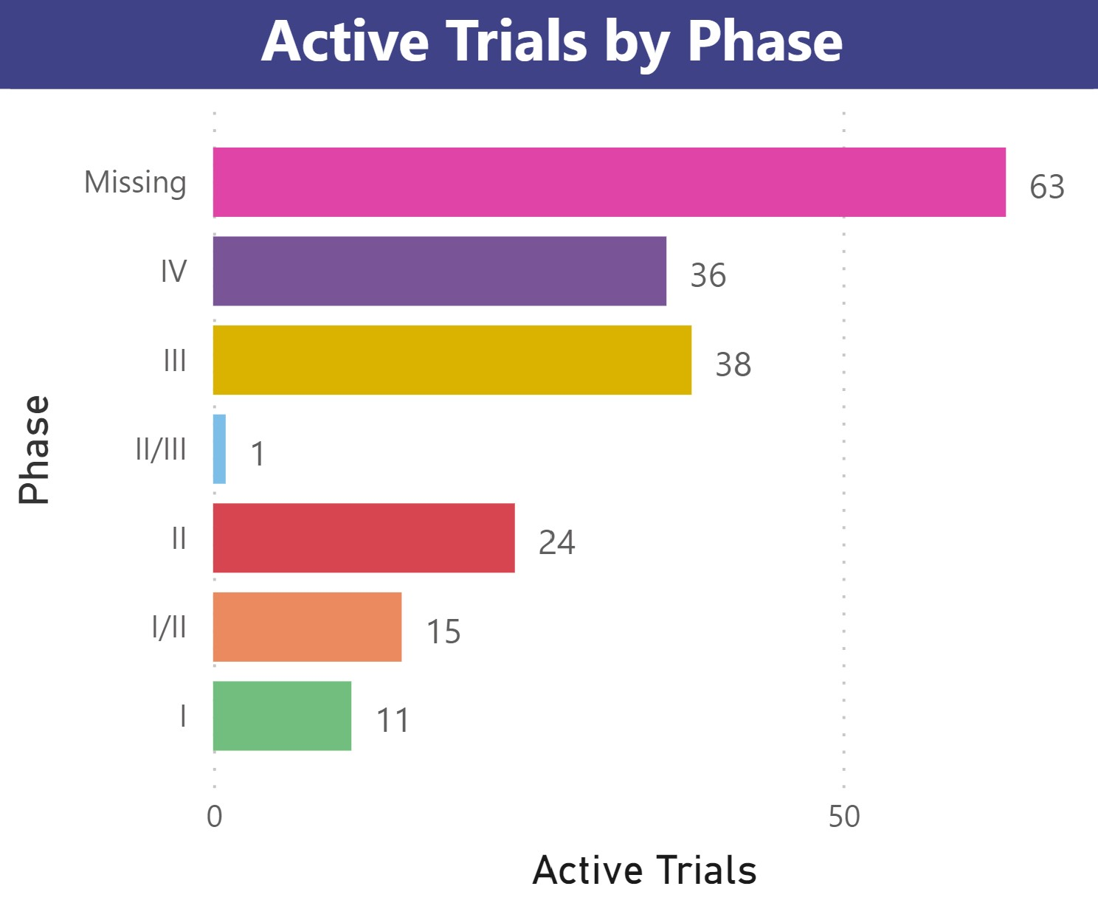
Trials by Phase
n = 188
Notes:
This slide set was prepared by AVAC. These slides display trends for active trials from clinicaltrials.gov as of June 2023. Underlying data is available for download at https://stiwatch.org/sti-database/
NOTE: This slide set is in the public domain. You may reproduce these slides without permission; however, citation as to source is appreciated.
You are also free to adapt and revise these slides; however, you must remove the AVAC STIWatch name and logo if changes are made.

Slide 7
Trials by Country
Notes:
Please note that geographic location is not available for all trials listed and some trials have multiple sites listed.
This slide set was prepared by AVAC. These slides display trends for active trials from clinicaltrials.gov as of June 2023. Underlying data is available for download at https://stiwatch.org/sti-database/
NOTE: This slide set is in the public domain. You may reproduce these slides without permission; however, citation as to source is appreciated.
You are also free to adapt and revise these slides; however, you must remove the AVAC STIWatch name and logo if changes are made.

Slide 8
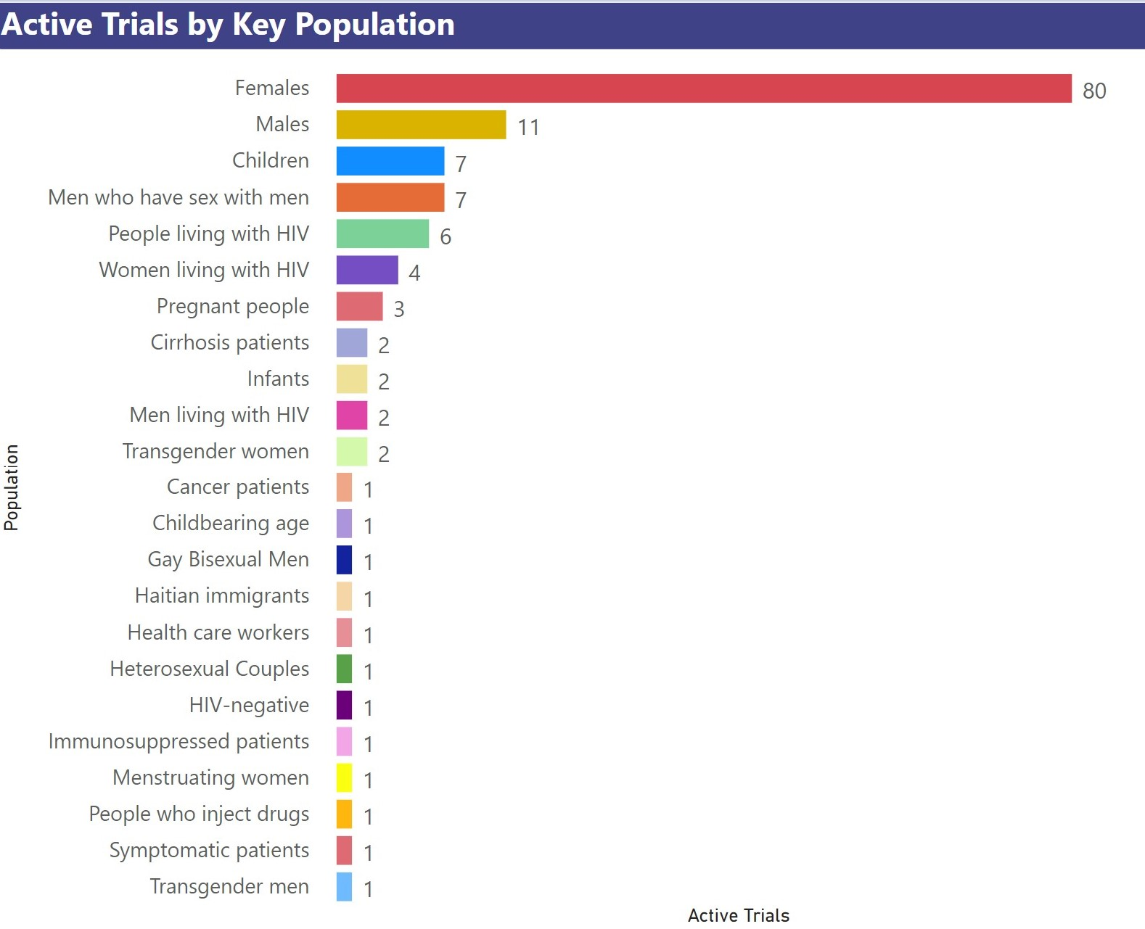
Trials by Key Population
Notes:
Please note that this graph was not drawn to scale.
This slide set was prepared by AVAC. These slides display trends for active trials from clinicaltrials.gov as of June 2023. Underlying data is available for download at https://stiwatch.org/sti-database/
NOTE: This slide set is in the public domain. You may reproduce these slides without permission; however, citation as to source is appreciated.
You are also free to adapt and revise these slides; however, you must remove the AVAC STIWatch name and logo if changes are made.

Slide 9
Trials by Start and End Date
Notes:
This slide set was prepared by AVAC. These slides display trends for active trials from clinicaltrials.gov as of June 2023. Underlying data is available for download at https://stiwatch.org/sti-database/
NOTE: This slide set is in the public domain. You may reproduce these slides without permission; however, citation as to source is appreciated.
You are also free to adapt and revise these slides; however, you must remove the AVAC STIWatch name and logo if changes are made.

